Slide 1
Action Research Defense
Example:
Fitness Testing of JSU Students

Slide 2
Identification of Problem
Certification of students that are NOT physically fit.
Fitness testing of PETE students
Policies
Cut-off scores

Slide 3
What is problematic about unfit PE teachers?
Credibility
Melville & Maddalozzo,1985
Whitley, Sage, & Butcher, 1988
Competence
Hetland & Strand, 2010
Staffo & Stier, 2000
Spittle, Petering, Kremer & Spittle, 2012

Slide 4
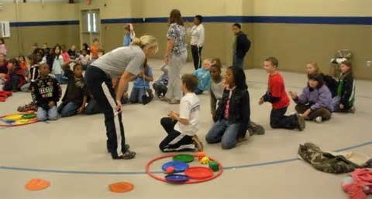
Those impacted
JSU students
JSU faculty
Schools hiring JSU students
Children at those schools

Slide 5
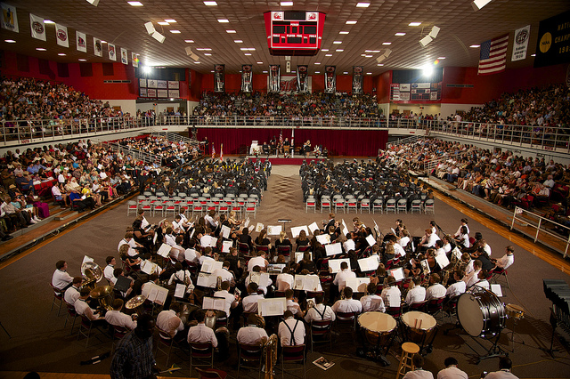
Representative Group
PETE faculty
JSU administration
Current PETE students

Slide 6
Parameters for Decision Making
Consensus of PETE faculty
Reassessed over time.
Fairness, legality, effectiveness

Slide 7
Gather Information:
Subjects: JSU PETE students
Fitness test : N=161
Questionnaire instrument: N=48
Administered in HPE courses
Voluntary
Data input in Excel & SPSS

Slide 8
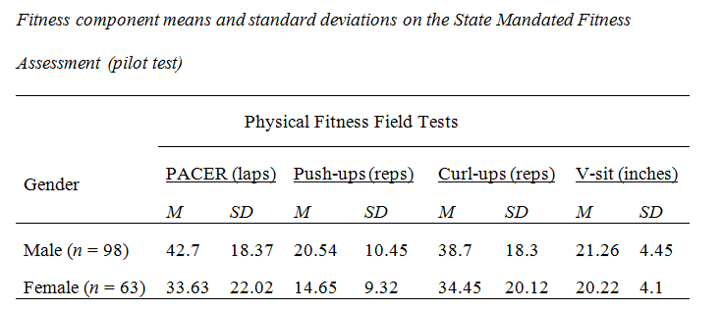
Gather Information: Fitness Test Scores
Historical norms
Current AFPA criteria
JSU scores

Slide 9
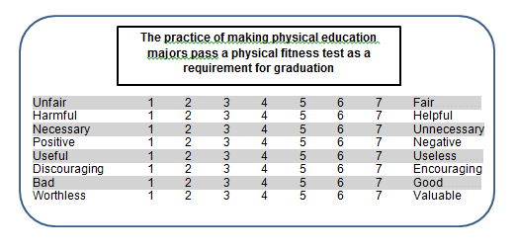
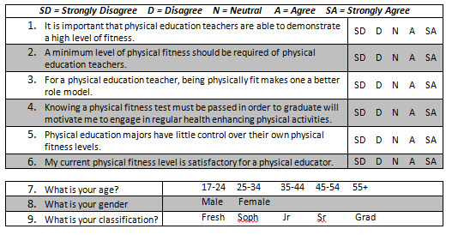
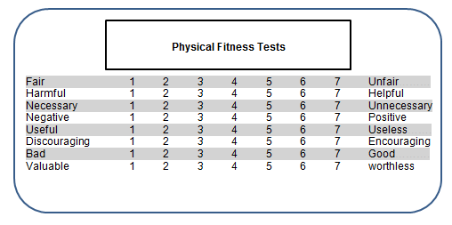
Gather Information: Instrument
Semantic Differential
Questionnaire
Open ended Questions

Slide 10
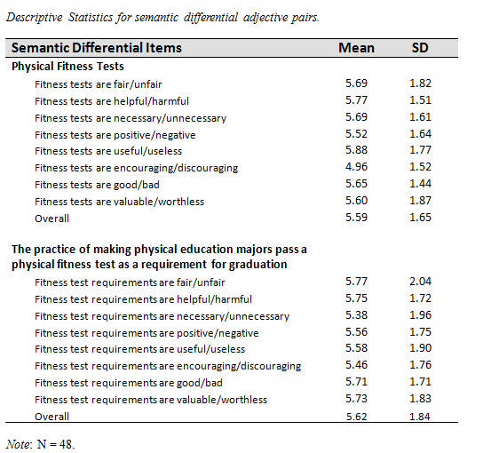
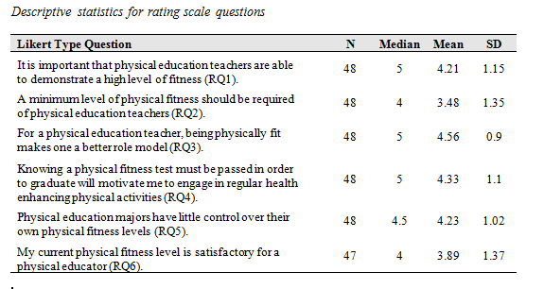
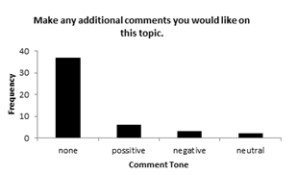
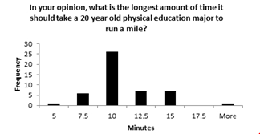
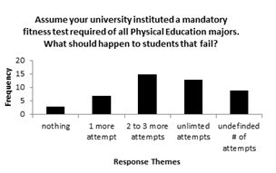
Gather Information: Instrument

Slide 11
Alternate Solutions
Use the AFPA, use 20%, adjust someplace between.

Slide 12
Alternate Solutions
Can solutions be supported by research and effective practices?

Slide 13
Alternate Solutions
Do solutions support the district’s vision and goals?

Slide 14
Alternate Solutions
How do solutions impact the district
curriculum, policies, other schools, departments, etc. ..?
Record Keeping
Class Time
Collaboration

Slide 15
Alternate Solutions
Show how solutions are better than current practices.

Slide 16
Questions

